Slide 1


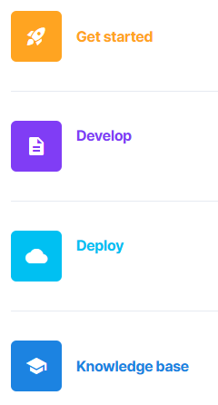
Advanced Data Analytics
Instructor: Chris Santo
Using Streamlit and Python for Advanced Data Analytics
Wednesday 6/3/2026

Slide 2

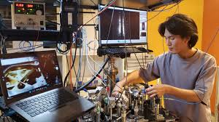
Warning: Experimental
I've never run these labs in a classroom. This is an experiment, so our results may vary. Please be kind on my surveys ☺

Slide 3

Streamlit
Streamlit follows a three-step process to app development/deployment:
#1 – Script the App Build an app in a few lines of code with Streamlit's "magically simple" API. In a local environment running Anaconda or similar, the app updates immediately in the browser when the code is updated. The API reference is here: https://docs.streamlit.io/develop/api-reference

Slide 4
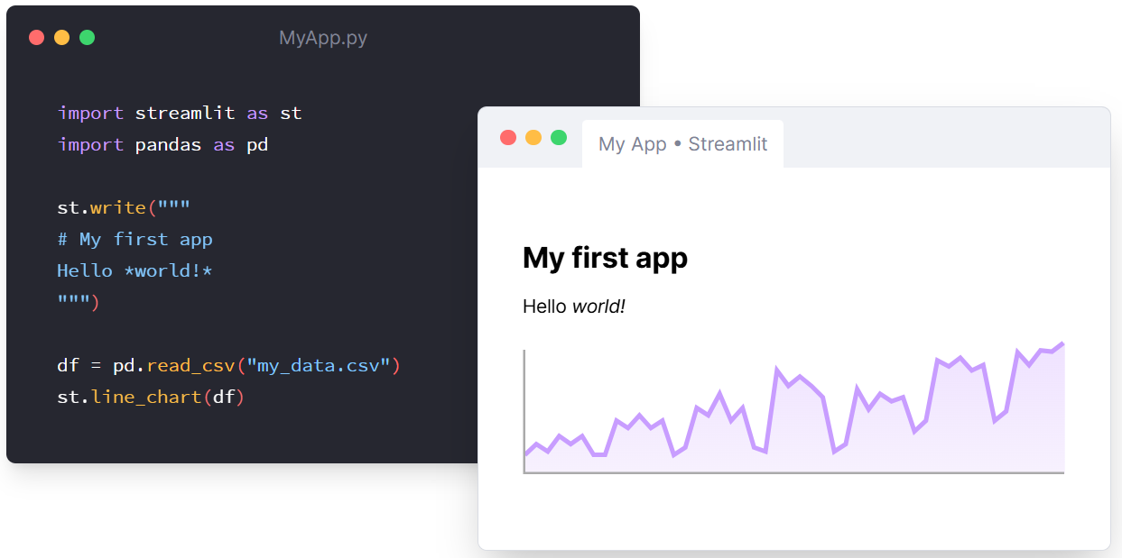
Streamlit
#1 -- Embrace Scripting

Slide 5
Streamlit
Streamlit follows a three-step process to app development/deployment:
#2 – Add interaction by using widgets Adding a widget in a Streamlit app is the same as declaring a variable in Python. The complicated backend processing is all handled for you by the Streamlit framework. Widget reference is here: https://docs.streamlit.io/get-started/fundamentals/main-concepts#widgets

Slide 6
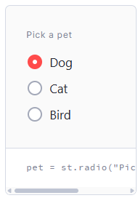
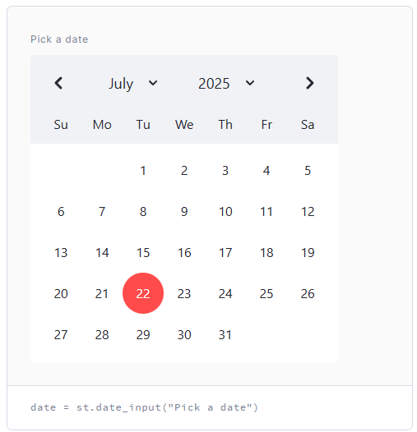
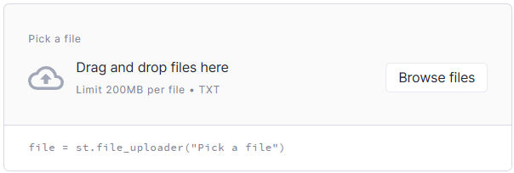
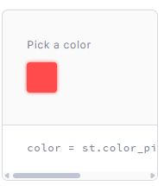
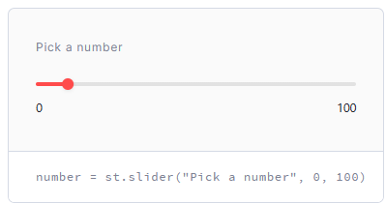
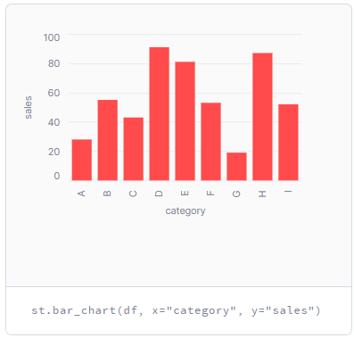
Streamlit
#2 – Add interaction by using widgets

Slide 7
Streamlit
Streamlit follows a three-step process to app development/deployment:
#3 – Deploy the app Using one of the methods we've discussed previously, deploy your app for testing or production use. Streamlit Community Cloud, Snowflake, Local/Anaconda, Google CoLab There are many, many other deployment methods: https://docs.streamlit.io/deploy/tutorials

Slide 8
Streamlit – Create your first app
This Streamlit lab will be run in the Google Colab environment.
Goals:
We will build a map-based visualization from one of the Streamlit tutorials.
This tutorial follows Streamlit's "Create your first app" tutorial at: https://docs.streamlit.io/get-started/tutorials/create-an-app

Slide 9
Streamlit – NYC Uber Pickup Lab
Lab Walkthrough Steps:
If you have the previous Hello World lab, save it, and make a copy by selecting File > Save a Copy in Drive
Rename this copy to "Streamlit NYC Uber Lab" by double-clicking at the top left and changing the name. *World!* :sunglasses:')

Slide 10
Streamlit – NYC Uber Pickup Lab
Lab Walkthrough Steps:
The streamlit python code for the hello world lab should be in cell #3, the cell that starts with %%writefile app.py
This magic command writes a file called app.py. Delete this cell from the workbook by hovering over the cell and clicking the trash can icon near the right side. To build our app, we are going to edit this file directly.
Click the file folder icon on left side of the notebook to show the file listing if it's not already shown, find the app.py file and double click.

Slide 11
Streamlit – NYC Uber Pickup Lab
Lab Walkthrough Steps:
6. Add the following code to the app.py file:
import streamlit as st import pandas as pd import numpy as np st.title('Uber pickups in NYC')

Slide 12
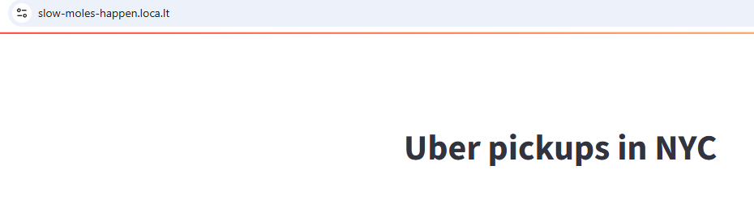
Streamlit – NYC Uber Pickup Lab
Lab Walkthrough Steps:
7. Run the remaining cells. Click the link shown in the output of the last cell, and copy/paste the IP address shown in the output of the next to last cell to be used as the password. Click "Click to submit". You should see your app:

Slide 13
Streamlit – NYC Uber Pickup Lab
Lab Walkthrough Steps:
8. Append the following code to the app.py file: (load_data function)
DATE_COLUMN = 'date/time'
DATA_URL = ('https://s3-us-west-2.amazonaws.com/'
'streamlit-demo-data/uber-raw-data-sep14.csv.gz')
def load_data(nrows):
data = pd.read_csv(DATA_URL, nrows=nrows)
lowercase = lambda x: str(x).lower()
data.rename(lowercase, axis='columns', inplace=True)
data[DATE_COLUMN] = pd.to_datetime(data[DATE_COLUMN])
return data

Slide 14
Streamlit – NYC Uber Pickup Lab
Lab Walkthrough Steps:
9. Append the following code to the app.py file: (test the load_data function)
# Create a text element and let the reader know the data is loading.
data_load_state = st.text('Loading data...')
# Load 10,000 rows of data into the dataframe.
data = load_data(10000)
# Notify the reader that the data was successfully loaded.
data_load_state.text('Loading data...done!')

Slide 15
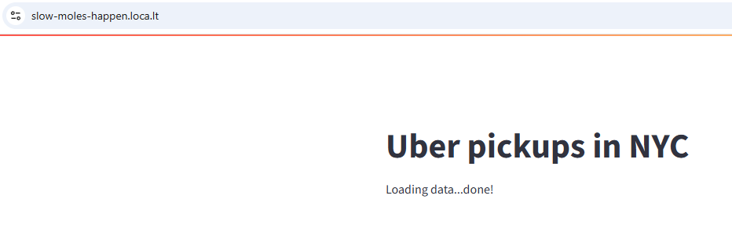
Streamlit – NYC Uber Pickup Lab
Lab Walkthrough Steps:
10. Refresh the browser window or click ellipses at top right of screen and select "re-run" or select "always re-run". The update should show:

Slide 16
Streamlit – NYC Uber Pickup Lab
Lab Walkthrough Steps:
11. Note that the entire python script is run each time your user interacts with your app. Do we want the data to be loaded each time? That could slow things down. Let's enable Streamlit's cache_data feature.

Slide 17
Streamlit – NYC Uber Pickup Lab
Lab Walkthrough Steps:
12. Add the following code to the app.py file before def load_data(nrows): (adding cache_data)
@st.cache_data
Replace the data_load_state.text…. line with the code line below.
data_load_state.text("Done! (using st.cache_data)")

Slide 18
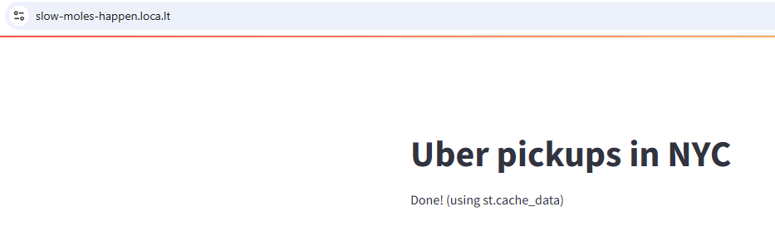
Streamlit – NYC Uber Pickup Lab
Lab Walkthrough Steps:
14. Go back to browser window and re-run your app. Notice how the line appeared immediately? It's subtle, but this caching can really improve the performance of your app, especially in data visualization scenarios.

Slide 19
Streamlit – NYC Uber Pickup Lab
Lab Walkthrough Steps:
Let's take a look at the raw data from our datasource. Append the following lines to app.py, then re-run your app.
st.subheader('Raw data')
st.write(data)

Slide 20
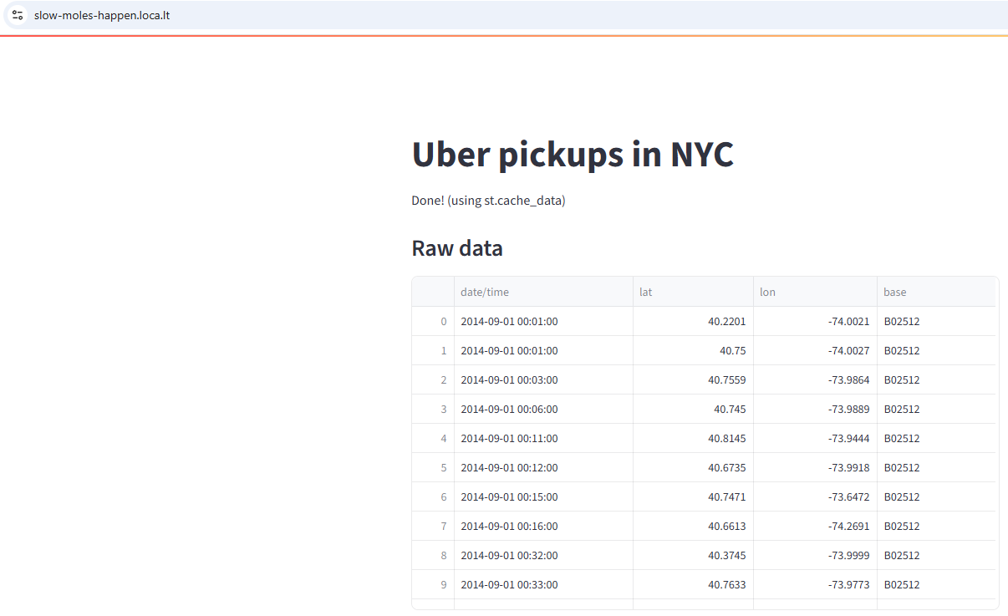
Streamlit – NYC Uber Pickup Lab
Lab Walkthrough Steps:
17. Using st.subheader and st.write, we can output a dataframe to our web app.

Slide 21
Streamlit – NYC Uber Pickup Lab
Lab Walkthrough Steps:
18. OK – Let's draw a histogram now. It's easy! Add the following lines to app.py, then re-run your app.
st.subheader('Number of pickups by hour')
hist_values = np.histogram(
data[DATE_COLUMN].dt.hour, bins=24, range=(0,24))[0]
st.bar_chart(hist_values)

Slide 22
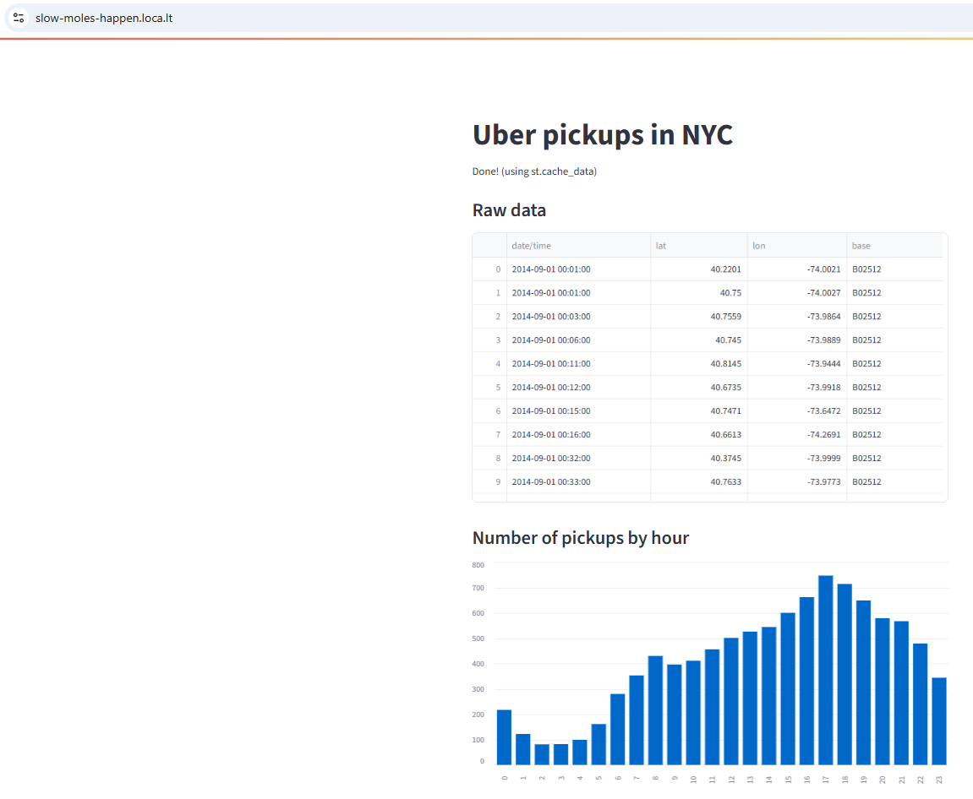
Streamlit – NYC Uber Pickup Lab
Lab Walkthrough Steps:
19. You got this!

Slide 23
Streamlit – NYC Uber Pickup Lab
Lab Walkthrough Steps:
20. Let's add a map. Pretty straightforward. Add the following lines to app.py, and re-run your app.
st.subheader('Map of all pickups')
st.map(data)

Slide 24
Streamlit – NYC Uber Pickup Lab
Lab Walkthrough Steps:
21. Perfection!

Slide 25
Streamlit – NYC Uber Pickup Lab
Lab Walkthrough Steps:
22. You want to focus on 17:00. That's the busiest time. Delete the last two lines we added and add the following lines to app.py, and re-run your app.
hour_to_filter = 17
filtered_data = data[data[DATE_COLUMN].dt.hour == hour_to_filter]
st.subheader(f'Map of all pickups at {hour_to_filter}:00')
st.map(filtered_data)

Slide 26
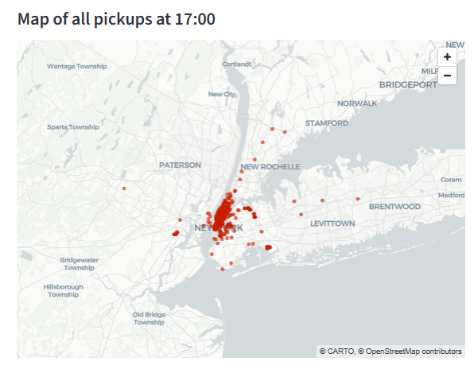
Streamlit – NYC Uber Pickup Lab
Lab Walkthrough Steps:
23. OK this is cool.

Slide 27
Streamlit – NYC Uber Pickup Lab
Lab Walkthrough Steps:
24. Do we have to be a developer to change the filter? Nope. Let's add a slider control. Replace the line "hour_to_filter = 17" and replace it with this line and re-run:
hour_to_filter = st.slider('hour', 0, 23, 17)
# min: 0h, max: 23h, default: 17h

Slide 28
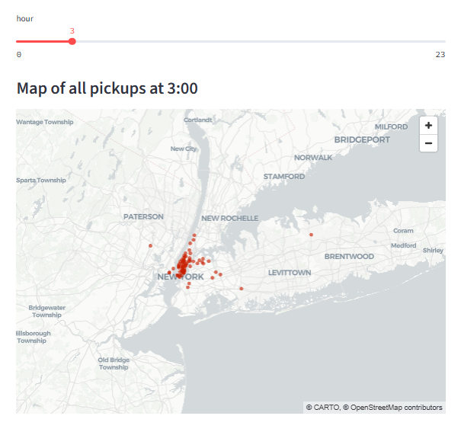
Streamlit – NYC Uber Pickup Lab
Lab Walkthrough Steps:
25. I'm loving it.

Slide 29
Streamlit – NYC Uber Pickup Lab
Lab Walkthrough Steps:
26. Maybe we don't want the raw data there all the time, and we just want it to show when we need it? Let's add a checkbox. Locate these lines in app.py and replace with the lines below. Re-run the app.
st.subheader('Raw data')
st.write(data)
if st.checkbox('Show raw data'):
st.subheader('Raw data')
st.write(data)

Slide 30
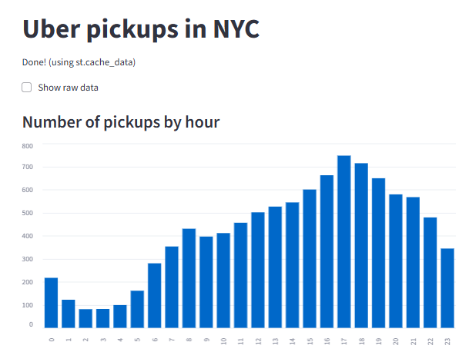
Streamlit – NYC Uber Pickup Lab
Lab Walkthrough Steps:
27. Raw data begone!

Slide 31
Streamlit – NYC Uber Pickup Lab
Lab Walkthrough Steps:
Let's add checkboxes for the other two visualizations too! Let's add one for the bar chart first. Locate the code in first box, indent and add the if statement below. Re-run your app.
st.subheader('Number of pickups by hour')
hist_values = np.histogram(
data[DATE_COLUMN].dt.hour, bins=24, range=(0,24))[0]
st.bar_chart(hist_values)
if st.checkbox('Show bar chart'):
<indented code from above>

Slide 32
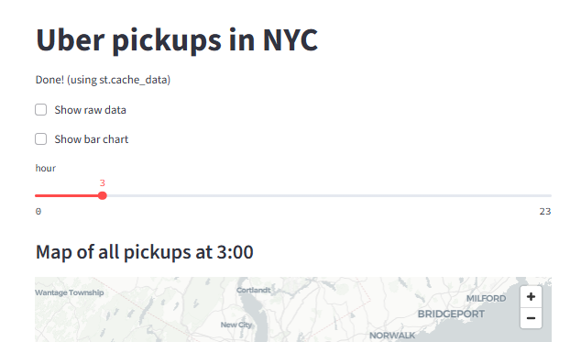
Streamlit – NYC Uber Pickup Lab
Lab Walkthrough Steps:
29. We're in control now!

Slide 33
Streamlit – NYC Uber Pickup Lab
Lab Walkthrough Steps:
One more for the map and slider. Locate the code in first box, indent and add the if statement below. Re-run your app.
hour_to_filter = st.slider('hour', 0, 23, 17)
filtered_data = data[data[DATE_COLUMN].dt.hour == hour_to_filter]
st.subheader(f'Map of all pickups at {hour_to_filter}:00')
st.map(filtered_data)
if st.checkbox('Show map'):
<indented code from above>

Slide 34
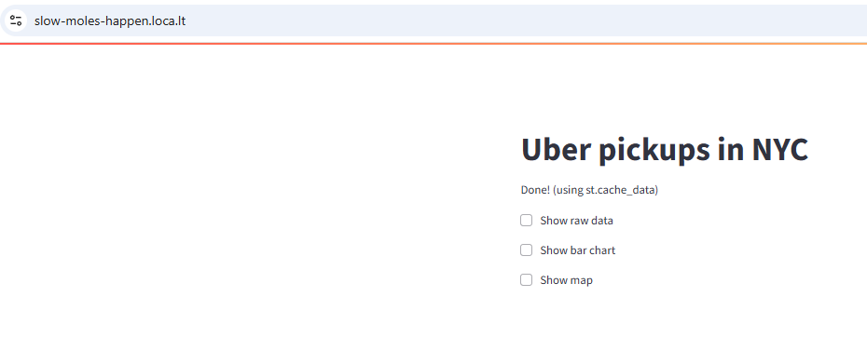
Streamlit – NYC Uber Pickup Lab
Lab Walkthrough Steps:
31. Looking clean!

Slide 35

Streamlit –NYC Uber Pickups Lab
Reflections – Comments – Questions?

Slide 36
Streamlit – Publish to Community Cloud
Now let's publish our Uber pickups app to Streamlit's Community Cloud
First, you need a github, and a new github repository.
> If you don't have a github, navigate to github.com and either sign in if you have a github account, or sign up if you need to create one. > Create a new repository. Navigate to Repositories and click New. > Name your repository. I suggest "streamlit". Make it public. > Click "Create repository"
(Instructor to Demo)

Slide 37
Streamlit – Publish to Community Cloud
Once you're in your repository….Now you need to add your streamlit python file.
> Click "Add File" > "Create new file" > Name the file "uber_nyc_pickups.py"
> Copy/Paste your app.py code from the colab notebook to here.
(Instructor to Demo)

Slide 38
Streamlit – Publish to Community Cloud
Once you're in your repository….Now you need to add your streamlit python file.
> Navigate to https://share.streamlit.io
> Click "Continue to sign-in" and use your same google account that you used for the github.
> Click "Create App" at top/right of screen. > Select "Deploy a public app from Github" > Pick the repository we just created from dropdown > Branch = main should be OK > Main file path = select the uber_nyc_pickups.py
> Note the app URL. Don't change it. Click Deploy.
(Instructor to Demo)

Slide 39
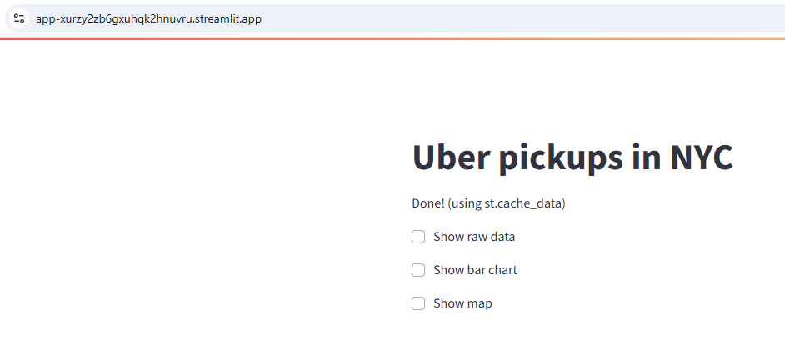
Streamlit – Publish to Community Cloud
Bazinga!

Slide 40
Streamlit – Publish to Community Cloud
Now, let's go back to github, and update the code.
Keep both the app browser window and github windows open at the same time if you can.
> Navigate in github to your uber_nyc_pickups.py code file > Click the "edit" pencil icon near the top right of the code window > Change the title to 'Uber pickups in NYC – UPDATED' > Click Commit Changes, then Commit Changes again on the popup window > Look at your app browser window – it automatically updates!
(Instructor to Demo)

Slide 41
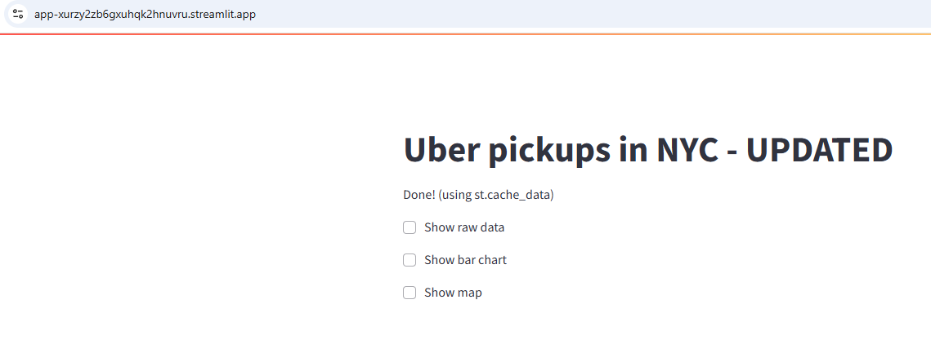
Streamlit – Publish to Community Cloud
Bazinga – UPDATED!

Slide 42
Streamlit – Community Cloud Lab
Reflections – Comments – Questions?

Slide 43

End

